Slide 1


Predicate logic lecture 3
Lamya A. Omer
2nd Stage
2020-2021
lamya.omer@uod.ac

Slide 2

Predicates designate sets!
Individual constants name individuals—persons, places, things, times, etc.
We resolve to understand properties and relations as sets—of individuals or ordered n-tuples of individuals (pairs, triples, quadruples, etc.)
Fido
is brown
{ brown things }
Predicates express properties which a single individual may have and relations which may hold on more than one individual

Slide 3
Predicate Logic Vocabulary
Individual Constants: lower case letters of the alphabet (a, b, c,…, u, v, w)
Predicates: upper case letters (A, B, C,…, X, Y, Z)
Connectives: ∼ , ∨ , • , ⊃ , and ≡
Variables: x, y and z
Quantifiers:
Existential (∃ [variable]), e.g. (∃x), (∃y)…
Universal (∀ [variable]) or just ([variable] ), e.g. (∀x), (∀y), (x), (y)…

Slide 4
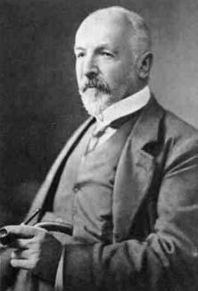
Sets
A set is a well defined collection of objects.
The elements of a set, also called its members, can be anything: numbers, people, letters of the alphabet, other sets, and so on.
Sets A and B are equal iff they have precisely the same elements.
Sets are “abstract objects”: they don’t occupy time or space, or have causal powers even if their members do.

Slide 5
Definitions
Deﬁnition: A predicate is a property that a variable or a ﬁnite collection of variables can have. A predicate becomes a proposition when speciﬁc values are assigned to the variables P(x1,x2,…..xn ) is called a predicate of n variables or n arguments .
Deﬁnition: The symbol ∀ is called the universal quantiﬁer.
The universal quantiﬁcation of P(x) is the statement “P(x) for
all values x in the universe”, which is written in logical notation as: ∀xP(x) or sometimes ∀x ∈ D, P(x).
Deﬁnition: The symbol ∃ is call the existential quantiﬁer and
represents the phrase “there exists” or “for some”. S.t
“There exists a value for x such that P(x) is true”, which is written ∃xP(x).
Note: If P(x) is true for at least one element in the domain, then
∃xP(x) is true. Otherwise it is false.

Slide 6
Predicates and Quantiﬁers
“Every computer connected to the university network is functioning properly.”
“MATH3 is functioning properly,”
where MATH3 is one of the computers connected to the university network.
“CS2 is under attack by an intruder,”
where CS2 is a computer on the university network, to conclude the truth of
“There is a computer on the university network that is under attack by an intruder.”

Slide 7
The statement “x is greater than 3” has two parts. The ﬁrst part, the variable x, is the subject of the statement. The second part—the predicate, “is greater than 3”
refers to a property that the subject of the statement can have.
We can denote the statement “x is greater than 3” by P(x),
where P denotes the predicate “is greater than 3” and x is the variable.
The statement P(x) is also said to be the value of the propositional function P at x.
Once a value has been assigned to the variable x, the statement P(x) becomes a proposition and has a truth value. Consider Examples 1 and 2.

Slide 8
EXAMPLE 1 Let P(x) denote the statement “x>3.” What are the truth values of P(4) and P(2)?
Solution: We obtain the statement P(4) by setting x = 4 in the statement “x>3.” Hence,
P(4), which is the statement “4 > 3,” is true. However, P(2), which is the statement “2 > 3,” is false.
3 Quantiﬁers
The operation “for all x” is formally known as a universal quantiﬁer.
“there exists an x”
“there exists an integer x
such that 5 < x < 100.” This means that at least one integer x (and possibly
a whole bunch of integers) satisﬁes the equation.
∀x ∈ R, ∀y ∈ R, x + y = x

Slide 9
Negating statements with quantiﬁers
Negating statements with quantiﬁers ¬(∀x, P(x)) = ∃x, ¬P(x)
¬(∃x, P(x)) = ∀x, ¬P(x)
So if we have something like
∀x, P(x) → (Q(x) ∧ R(x))
Its negation is
¬(∀x, P(x) → (Q(x) ∧ R(x))) = ∃x, ¬(P(x) → (Q(x) ∧ R(x)))
= ∃x, P(x) ∧ ¬(Q(x) ∧ R(x)))
= ∃x, P(x) ∧ (¬Q(x) ∨ ¬R(x))

Slide 10
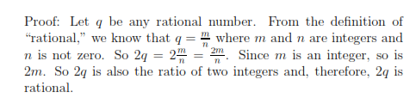
Proving a universal statement
For every rational number q, 2q is rational.
First, we need to deﬁne what we mean by “rational”.
The simplest technique for proving a claim of the form ∀x ∈ A, P(x) is
to pick some representative value for x.

Slide 11
Proving existential statements
There is an integer k such that k²= 0.
Proof: Zero is such an integer. So the statement is true.
Consider the following sentences:
”The number 3x + 2 is an even number”.
The sentence is not a proposition and contain the single variable x. When x is speciﬁed, the sentence becomes a proposition. We call a declarative sentence an open statement if
• it contains one or more variables, and
• it is not a proposition, but
• it becomes a proposition when the variables in it are replaced by certain allowable choices.

Slide 12
Example:- Use quantiﬁers to express the statement
”Every student in computer-department knows what Discrete Mathematics is”.
Solution:-
Let p(x) :=“x knows what discrete Mathematics is”.
Then the statement can be written as
∀x p(x),
where the universe of discourse consists of all students in computer-department .
Let s(x) :=“x is a student in computer-department”
Then the statement can be expressed as
∀x(s(x) → p(x)).

Slide 13
Example :- Express the following statements in quantiﬁers. Everyone has one good friend.
Let p(x, y) be the statement “y is a good friend of x”.
Then the statement can be expressed as
∀x∃yp(x, y).
Negating Quantiﬁes
• ¬(∀x p(x)) = ∃x ¬p(x).
• ¬(∃x p(x)) = ∀x ¬p(x).
Example:-
Negate the following quantiﬁers:
(1) ∀x∃y p(x, y)
(2) ∃x∀y[ p(x, y) → q(x, y)].

Slide 14
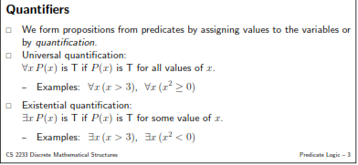
Universal Quantification
Let A be an expression, and let x be a variable. If we want to say that P(x) is true for all substitutions of values for x we write ∀x P(x).
Examples:
All cats have tails, ∀x(cat(x) ⇒ has Tail(x)).
For every integer x, x+1 > x, ∀x(>(x+1, x)).

Slide 15
Existential Quantification
Let A be an expression, and let x be a variable. If we want to say that P(x) is true for at least one value of x, we write ∃x P(x).
Examples:
Some people like apples, ∃x (likes Apples(x)).
There is an integer larger than 10, ∃x(>(x, 10)).
(Everybody loves somebody.)

Slide 16
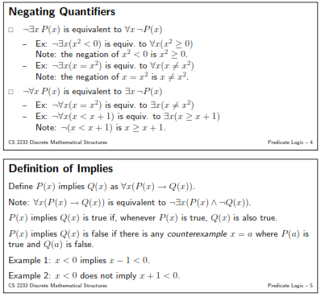

Slide 17


Everybody loves somebody
(x)(∃y)L(x,y): for all x, there exists a y such that x loves y

Slide 18
Everybody is loved by somebody
(x)(∃y)L(y,x): for all x, there exists a y such that y loves x

Slide 19
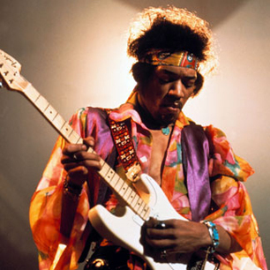
There’s somebody everybody loves
(∃x)(y)L(y,x): There exists an x such that for all y, y loves x

Slide 20
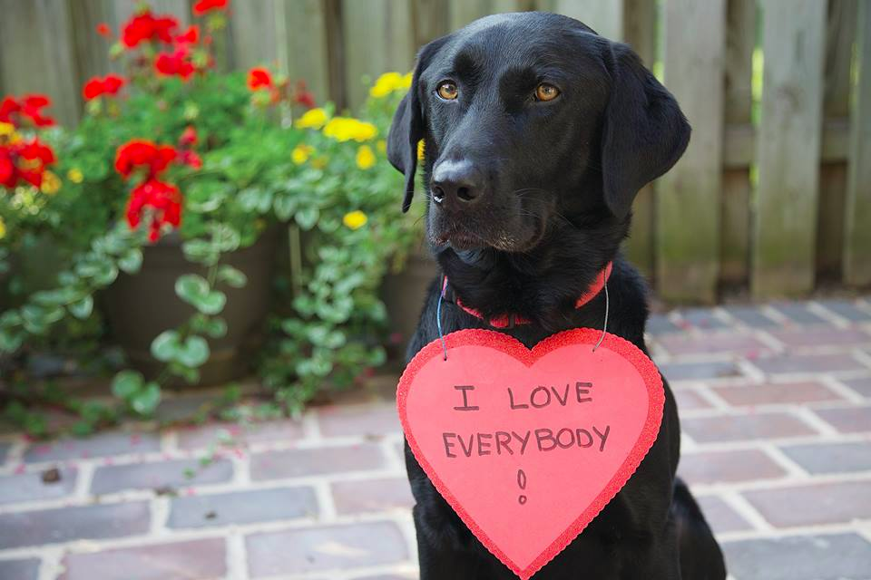
There’s somebody who loves everybody
(∃x)(y)L(x,y): there exists an x such that for all y, x loves y

Slide 21
Exercises
Translate the following into English.
1. ∀x[x²= 0].
2. ∃t[(t > 3) ∧ (t³> 27)].
3. ∀x[(2/x) ∨ (2 6/x)]
Translate the following into logic statements.
1. There is an integer whose square is twice itself.
2. No school buses are purple.
3. If a real number is even, then its square is even.

Slide 22
Exercises
Example:
N(x): x is a non-negative integer
E(x): x is even
O(x): x is odd
P(x): x is prime
Translate into logical notation.
1. There exists an even integer.
2. Every integer is even or odd.
3. All prime integers are non-negative.
4. The only even prime is 2.
5. Not all integers are odd.
6. Not all primes are odd.
7. If an integer is not odd, then it is even.

Slide 23
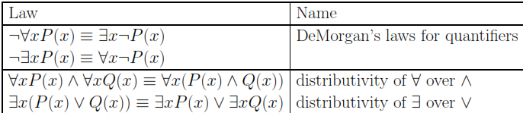
Example: Some cats purr.
Negation: No cats purr.
I.e., if it is false that some cats purr, then no cat purrs
DeMorgan’s laws for quantiﬁers:
¬∀xP(x) = ∃x¬P(x)
¬∃xP(x) = ∀x¬P(x)
Exercise: Show that
1. (∀xP(x) ∨ ∀xQ(x)) → ∀x(P(x) ∨ Q(x)) is true.
2. ∀xP(x) ∨ ∀xQ(x) 6= ∀x(P(x) ∨ Q(x))
Logical Relationships with Quantiﬁers

Slide 24
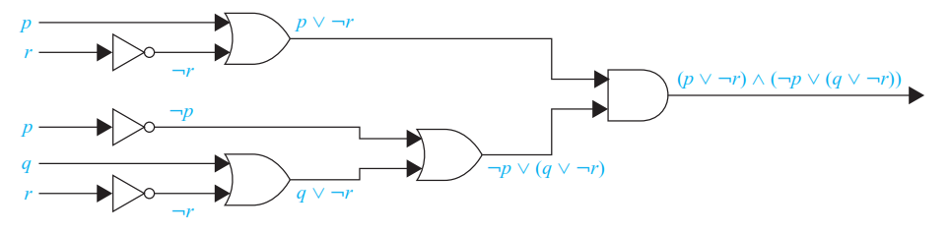
we can systematically build a digital circuit with the
desired outputExample:
Build a digital circuit that produces the output (p ∨¬r) ∧ (¬p ∨ (q ∨¬r)) when given input bits p, q, and r.
Solution:

Slide 25
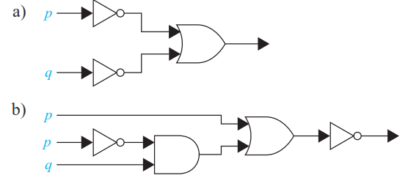
Find the output of each of these combinatorial circuits.

Slide 26
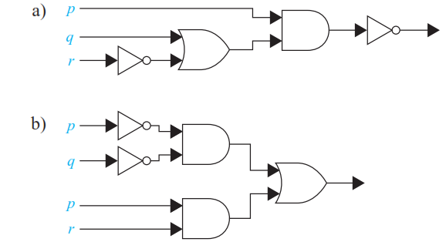
Find the output of each of these combinatorial circuits

